Slide 1

Secure File Sharing for Secret Agencies with Hybrid Crypto graphical and Fragmentation systems
by
D. Sushmitha
Roll No. 204G1A05A7
P. Vaishnavi
Roll No. 204G1A05B6
U. Sai Nithyusha
Roll No. 204G1A0588
B. Obi Reddy
Roll No. 214G5A0510
Under the guidance of
Mr. P. Praneel Kumar M.Tech, (Ph.D)
Assistant Professor
Department of Computer Science and Engineering
Srinivasa Ramanujan Institute of Technology
Autonomous
Rotarypuram Village, B K Samudram Mandal, Ananthapuramu – 515701.
2023-2024

Slide 2
Comments
Why files are divided into seven fragments?
Why is Hybrid Cryptography specifically used?
How does the Triple DES work?
What is the use of Blowfish Algorithm?

Slide 3
Contents
Abstract
Introduction
Literature Survey
Existing System
Proposed System
Planning
Design
Implementation
Research Paper
References

Slide 4
Abstract
Nowadays, Storing a large amount of data in a single file on the cloud can lead to issues like slow data access, less security, and difficulties in data management. To provide the solution for these we are using the Cryptography technique for data security. Hybrid cryptography involves a combination of symmetric and asymmetric encryption techniques to ensure the confidentiality and integrity of files in the cloud.
The file is split into seven fragments. Every part of the file is encrypted with the help of AES, Triple DES, and Blowfish algorithms by applying fragmentation. For decrypting reverse process of encryption is applied.
Keywords: Hybrid Cryptography, Fragmentation, Cloud Computing, AES, Triple DES, Blowfish.

Slide 5
Introduction
By using fragmentation, we are putting into practice a secure cloud storage system that uses the AES, Triple, DES, and Blowfish algorithms. Our systems are open to information sharing by secret agencies. The modules Administrator, Data Owner, Data User, and Cloud Server are part of our project. The administrator is in charge of handling file access rights, data owner accounts, and data user accounts.
The uploads and downloads can be observed by the administrator. The files will be uploaded into the system by the data owner. On the file, we are using double encryption.
Seven pieces will be taken from the created cipher text. The Firebase cloud will get these pieces. By requesting that the seven fragments merge into a single fragment and that the file has two descriptions applied, the user can receive the files.
As the file key, the plain text will download. After the data owner processes the user's request, the key will be sent to them via email. The file will download if the key is legitimate. during a text file download. The cloud can monitor data owners' and users' details, as well as track uploads and downloads.

Slide 6
Literature survey
Y. Yang, X. Liu, R.H. Deng [1] Hybrid Cryptography Scheme A hybrid cryptography system is characterized by the integration of many cryptographic algorithms. As a result of this diversity, important files are kept in a more secure environment by increasing complexity and resistance to attacks. Breakdown Structures The Use of fragmentation systems strengthens file security much further in addition to cryptographic diversity. By splitting up files into smaller pieces, information is dispersed and becomes harder for hackers to access or reconstruct its whole.
W. Sun, S. Yu, W. Lou, Y. Hou and H. Li,[2] increased the use of many algorithms (AES, Blowfish, and 3-DES) in Secure File Sharing for Secret Agencies with Hybrid Cryptographical and Fragmentation Systems. This strategy aims to offer a strong barrier against any dangers and unwanted access. Here is a brief synopsis. These are Multiple Algorithm Integrations that show a layered security strategy by combining AES, Blowfish, and 3-DES and use each algorithm's advantages to improve overall file protection. Strengthened Security for Covert Organizations Sensitive material has higher security needs, which are acknowledged by the particular application of this hybrid technique in Secure File Sharing for Secret Agencies. Finding a Balance Between Security and Performance It's important to take performance into account when improving security

Slide 7
Literature survey
M. Green, S. Hohenberger, and B.Waters, [3] In this proposed system 3DES (Triple Data Encryption Standard), RC6 (Rivest Cipher 6) and AES (Advanced Encryption Standard) algorithms are used to provide security to data. All the algorithms use 128-bit keys. LSB steganography technique is used to securely store the key information. Key information will contain the information regarding the encrypted part of the file, the algorithm, and the key for the algorithm. File during encryption is split into three parts. These individual parts of the file will be encrypted using different encryption algorithms simultaneously with the help of a multithreading technique. The key information is inserted into an image using the LSB technique. Our methodology guarantees better security and protection of customer data by storing encrypted data on a single cloud server, using AES, DES, and RC6 algorithms.
J. Lai, R. H. Deng, C. Guan, and J. Weng, [4] The proposed scheme is proved selective-structure chosen plaintext secure and master key secure without random oracles. Besides, we develop another kind of key delegating capability in our scheme and also discuss some related issues including a stronger security model and applications.

Slide 8
Literature survey
Z. Liu, Z. Cao, D.S. Wong, [5] Attribute based proxy re-encryption scheme (ABPRE) is a new cryptographic primitive which extends the traditional proxy re-encryption (public key or identity based cryptosystem) to the attribute based counterpart, and thus empower users with delegating capability in the access control environment. Users, identified by attributes, could freely designate a proxy who can re-encrypt a cipher text related with a certain access policy to another one with a different access policy.

Slide 9
Existing System
Now ways the internet users utilizing cloud service in many ways. The cloud will not available at the customer end physically. The customer can access the cloud vertically. The customers not even knows where the data storing and how the data storing. In this case we need to trust the service providers. It’s very challenging issue. Particularly for the secrets agencies. The information is everything, sharing the information securely is a challenging issue. When we use secure socket layer (SSL).
The information over the internet is encrypted, information will transfer securely from client to server and server to client. But the original data will store in the cloud database. For this we need to encrypt the data while uploading into the cloud. There many cryptography techniques available to encrypt the data. Still in case of keys stolen the information can decrypt.

Slide 10
Proposed System
In our project we have the modules named Administrator, Data owner, Data User and Cloud server. The administrator can login with default credentials. The data owner and data user will register from our application. We are not giving access to the anonymous persons, the administrator needs to verify the data owner and data user. After verification the data owner and data user can login into the system.
The Data owner will upload the files into the cloud, the data user will download the files from the cloud. We are using Firebase real time database as our cloud. We are using double encryption with fragmentation,we are using AES, Triple DES and blowfish encryption techniques to secure the secrete agencies data while sharing over the cloud.
It is achieved by creating user-friendly screens for the data entry to handle large volume of data.

Slide 11
Planning
Performance
Encryption and Decryption Overhead the computational overhead of encrypting and decrypting files using hybrid cryptography algorithms can impact performance.
Fragmentation and Reconstruction fragmenting files into smaller chunks and reconstructing them during file retrieval can introduce latency, especially for large files.

Slide 12
Planning
Functional Requirements
Users must authenticate themselves before accessing the file sharing system, using methods such as username/password.
All files must be encrypted using hybrid cryptography techniques to ensure confidentiality. This involves both symmetric and asymmetric encryption methods.
Files should be fragmented into smaller chunks before encryption to enhance security.
Secure management of encryption keys, including generation, storage, rotation, to prevent unauthorized access to files.
Non-Functional Requirements
Security
Scalability
Reliability
Adaptability

Slide 13
Planning
System Requirements:
Hardware Requirements:
RAM : 8 GB
Hard Disk : 500 GB
System Processor : I5
Software Requirements:
Operating system : Windows 10
Coding Language : Python
Database : MYSQL

Slide 14
Planning
Methodology
A robust methodology for secure file sharing for secretive agencies with hybrid cryptography and fragmentation systems involves several key steps:
Risk Assessment
Requirements Gathering
System Design
Implementation
Testing
Advantages:
The System is very secure and robust in nature.
Data is kept secure on a cloud server which avoids unauthorized access.
The key is also safe as it embeds the keys using methods.

Slide 15
Planning
IMPLEMENTATION:
MODULES:
Admin
2. Data User
3. Data Owner
4. Cloud

Slide 16
Planning
Administrator:
Once the administrator logs in using the default credentials, they can act as the application's owner by activating and deactivating the user and owner. If the username and password are entered correctly, only the administrator can access the home page; if they are entered incorrectly, the administrator cannot access the home page. All file details that are downloaded and uploaded can be viewed by the admin. The administrator will grant the data user permission to access the file. Having the authorization to access the file. The user of the data cannot access the data.
1. Verify Users
2. Verify Owners
3. View Uploaded Files
4. Accept User request
5. View User download details

Slide 17
Planning
Data Owner:
The owner of the data will sign up through our application. We do not grant access to anonymous users; instead, the administrator must authenticate the owner of the data. The data owner can log in to the system after verification. The files will be uploaded into the cloud by the data owner. Our cloud is a Firebase real-time database. The files will be uploaded by the data owner to the cloud server. The text file will be encrypted using the AES encryption algorithm during upload. Subsequently, if the file size is little, Blowfish encryption will be used for the second encryption, and if the file size is large, Triple DES encryption will be used. The file that is double encrypted will split into seven equal pieces. The Firebase Realtime Database Cloud will house the seven pieces. We are utilizing MySql as our local database, and it will house the encryption keys. The cloud is where we are keeping the encrypted data. The file keys are not kept on cloud storage. The file uploaded can be viewed by the data owner.
1. Register
2. Login
3. Upload File
4. View Uploaded Files
5. Send Key To User

Slide 18
Planning
Data User:
The administrator must validate the data user after they register with our application. The user can log in to the system after the data has been verified. The files will be downloaded by the data user from the cloud. The data user will obtain permission to browse the list of files that are available in the cloud before downloading the file from the cloud. The administrator will get the file access request from the data user. The data user can examine the files that are available in the cloud if the administrator grants the request. A data user must submit a request to the data owner in order to download the file. The key will generate and be sent to the data user's email address while the request is approved by the data owner.
1. Login
2. Register
3. Send Access Request
4. View Files
5. Send Request
6. Download File
7. View Downloaded Files

Slide 19
Planning
Cloud:
The admin of the cloud module, who has access to all registered users and owners’ details, as well as information on uploaded and downloaded files, can run the cloud module. The cloud person is able to keep an eye on cloud activity.
1. View Users
2. View Uploaded Files
3. View Data Owners
4. View User downloaded Files

Slide 20
Planning
Work Schedule
S.No | Development Stage | Duration
1. | Domain and Title | 1 week
2. | Literature Survey | 2 weeks
3. | Planning | 1 week
4. | Design | 1 week
5. | Requirements Gathering | 1 week
6. | Testing | 3 weeks
7. | Implementation | 4 weeks

Slide 21
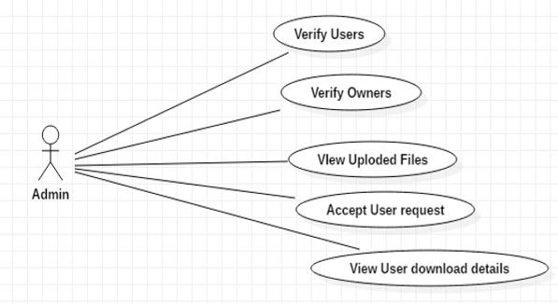
Design – Administrator Diagram

Slide 22
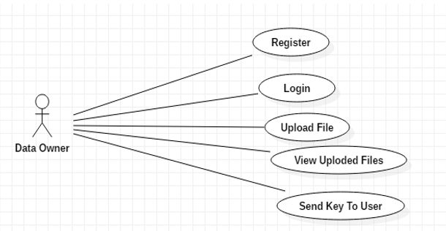
Design - Data Owner Diagram

Slide 23
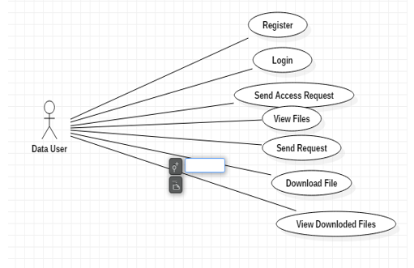
Design – Data User Diagram

Slide 24
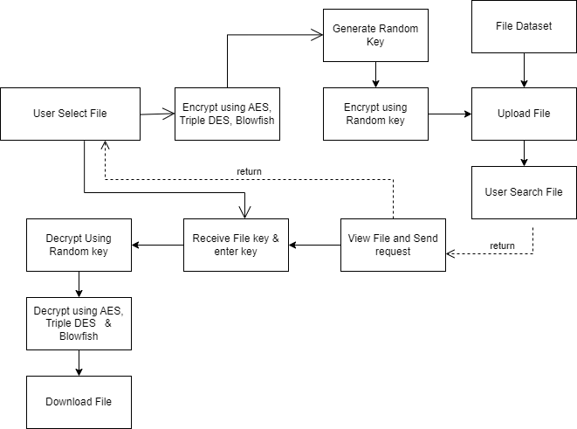
Design – Flow Chart

Slide 25
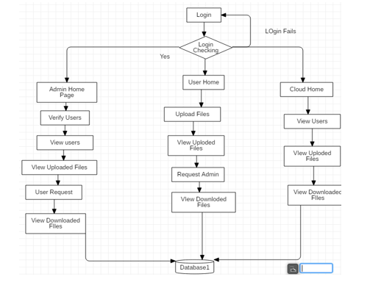
Design- Data Flow Diagram

Slide 26
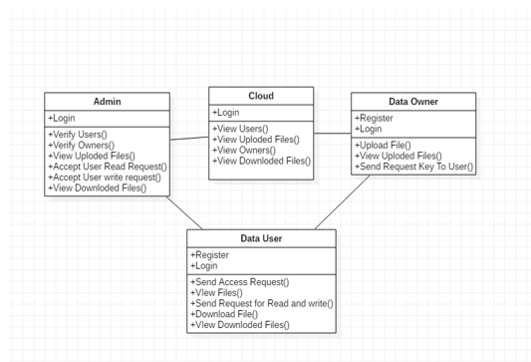
Design – Class Diagram

Slide 27
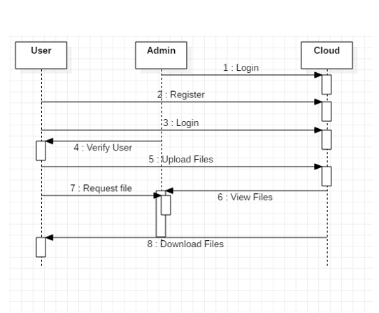
Design: Sequence Diagram

Slide 28
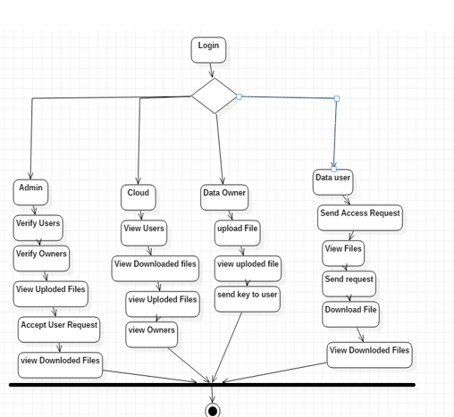
Design: Activity Diagram

Slide 29
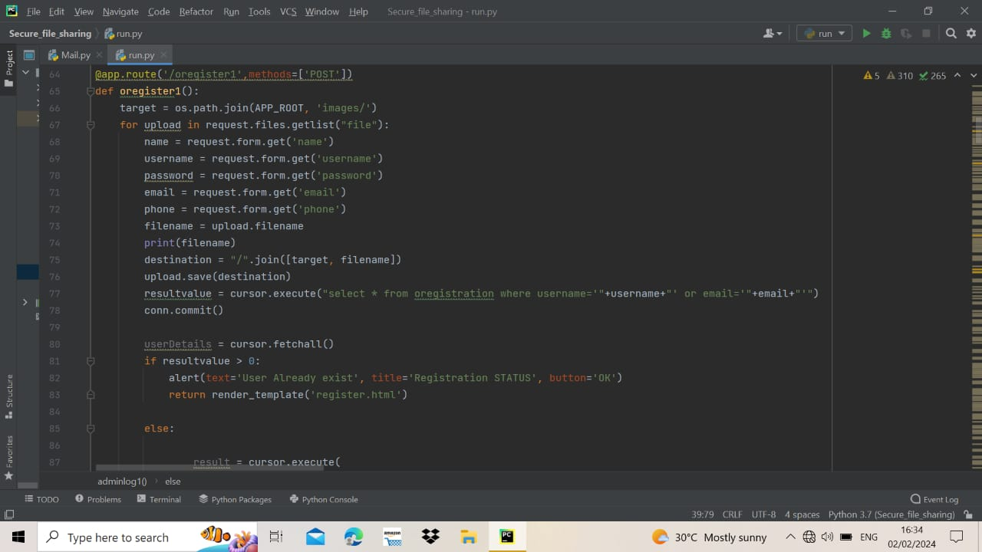
Implementation

Slide 30
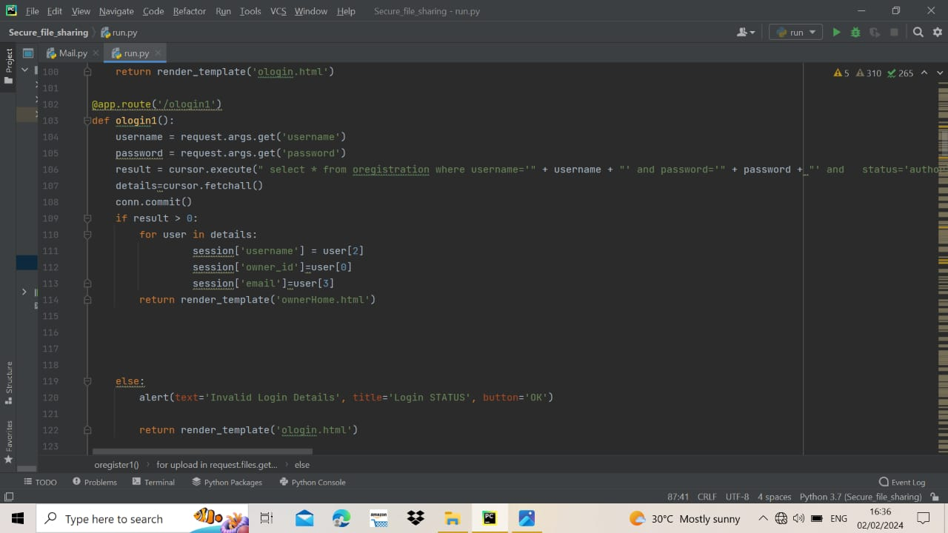
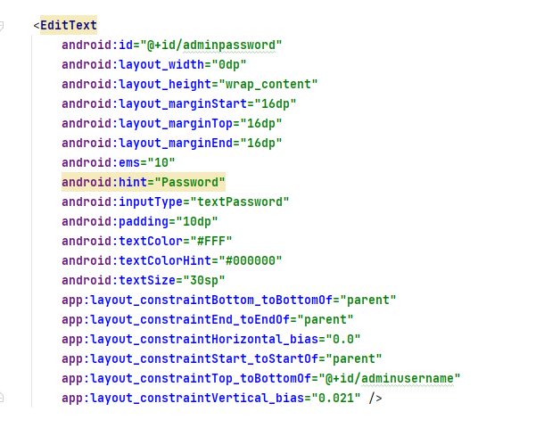
Implementation

Slide 31
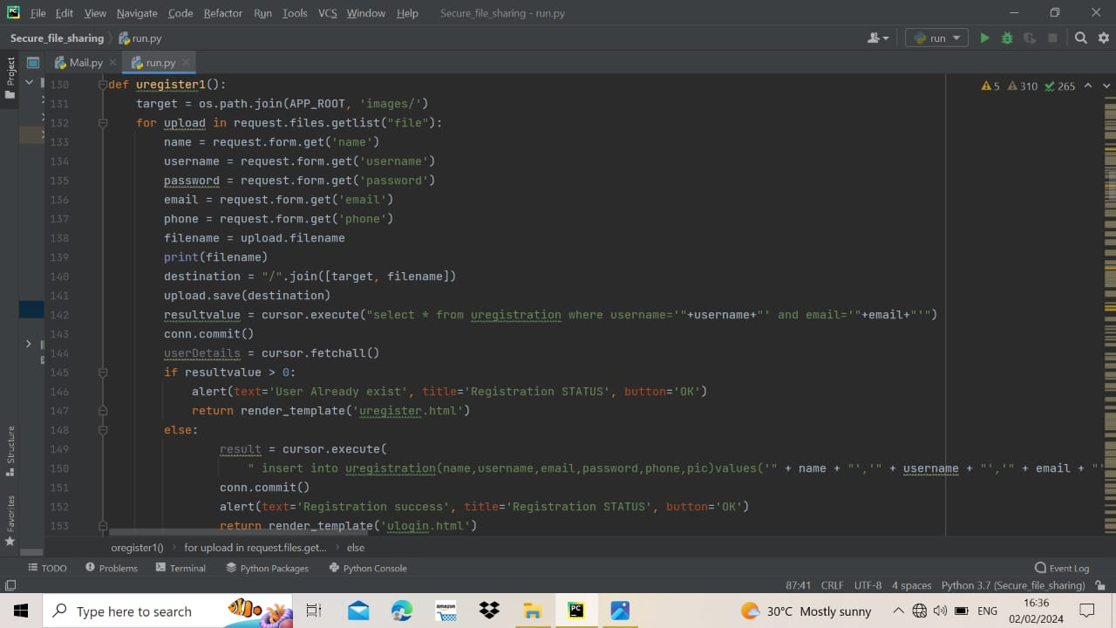
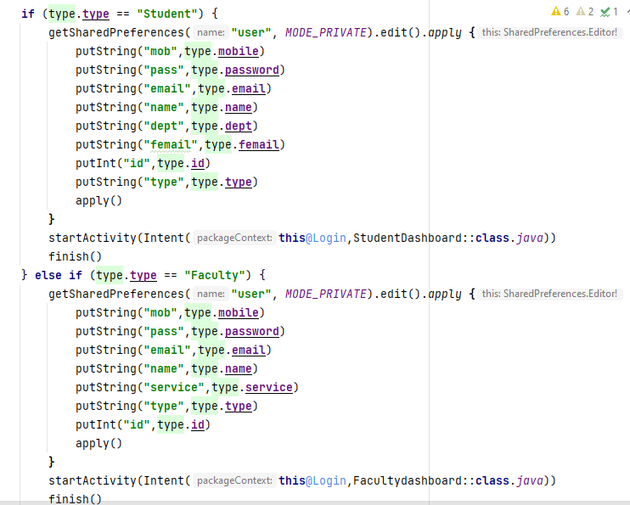
Implementation

Slide 32
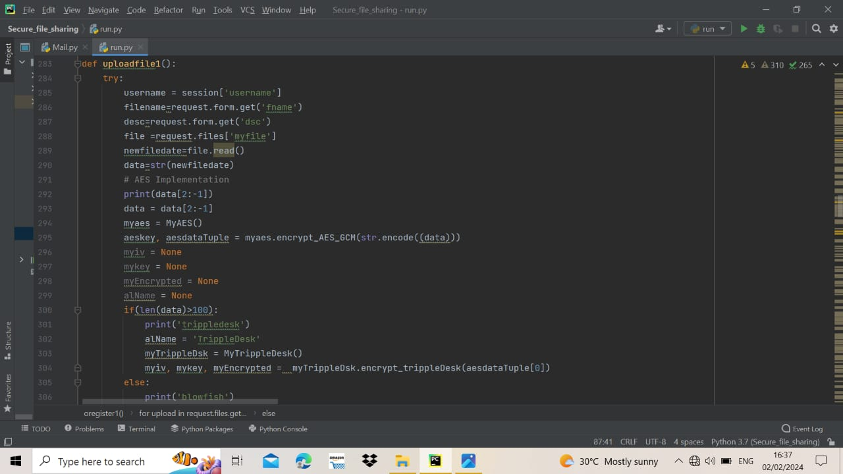
Implementation

Slide 33
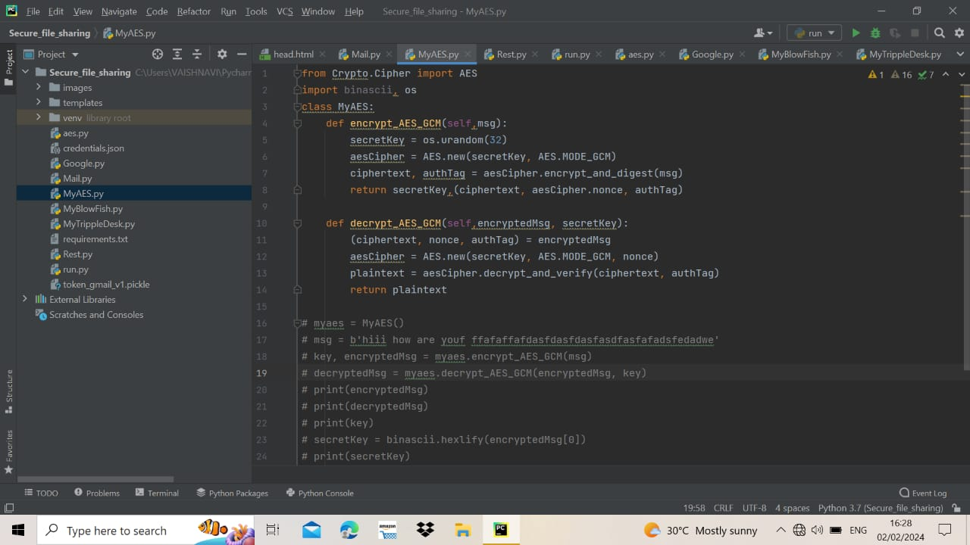
Implementation

Slide 34
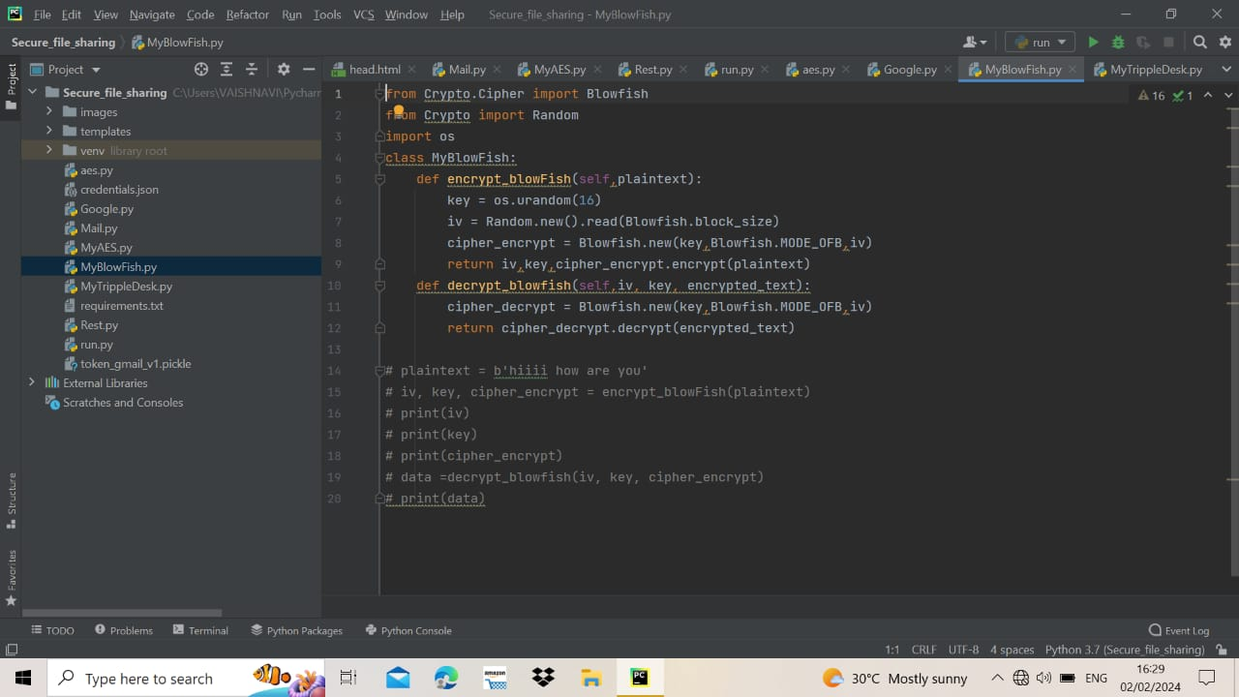
Implementation

Slide 35
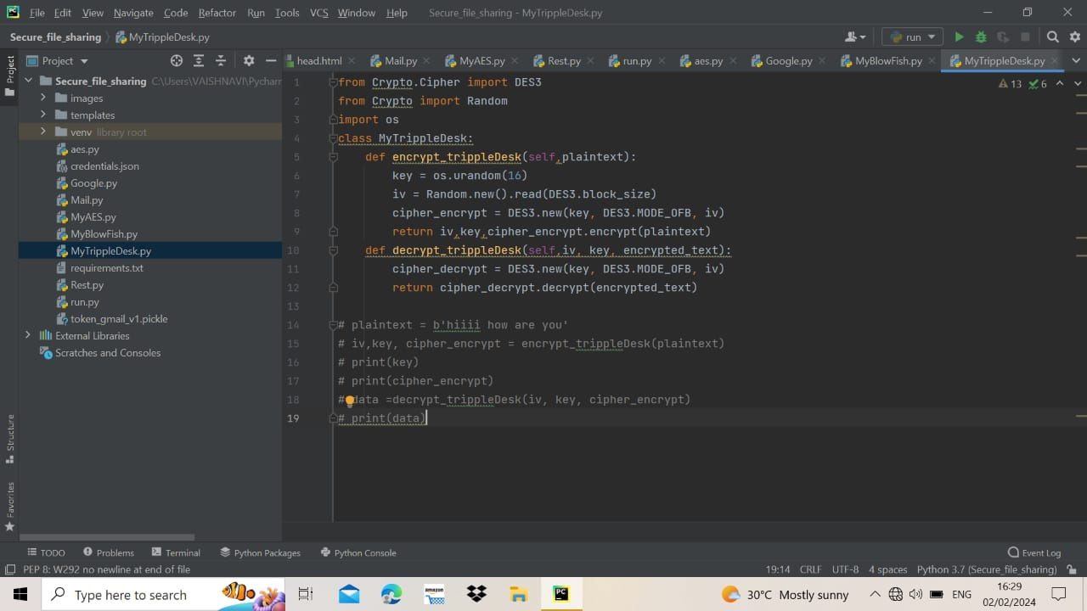
Implementation

Slide 36
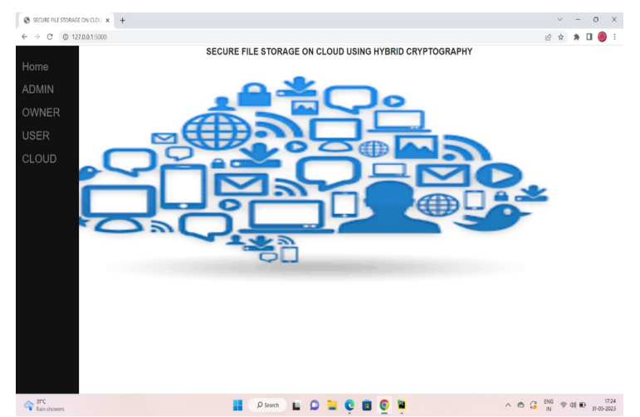
Implementation

Slide 37
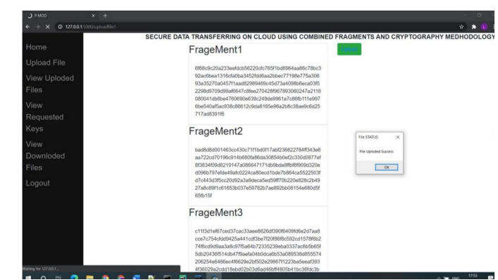
Implementation

Slide 38
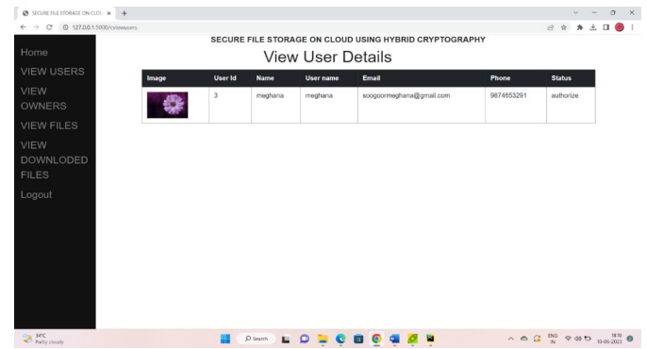
Implementation

Slide 39
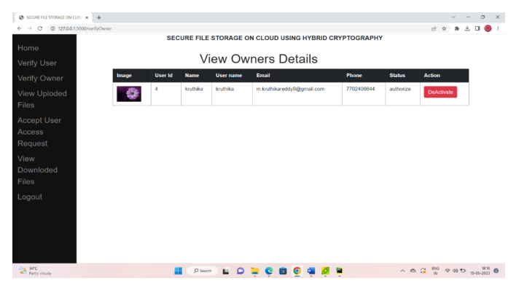
Implementation

Slide 40
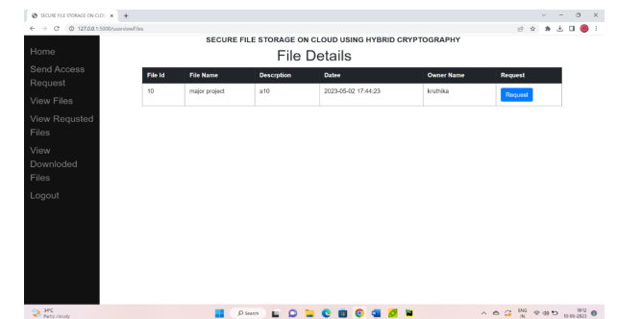
Implementation

Slide 41
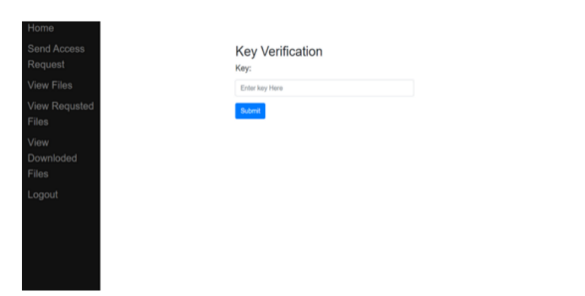
Implementation

Slide 42
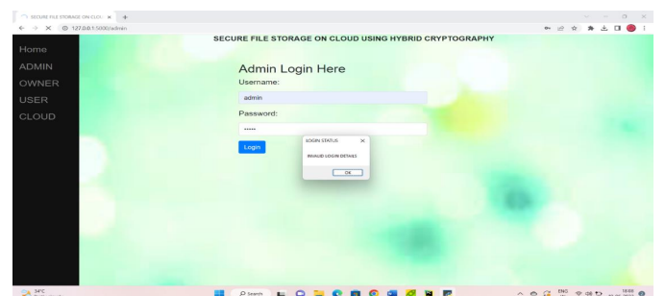
Implementation

Slide 43
Research Paper
Research Paper

Slide 44
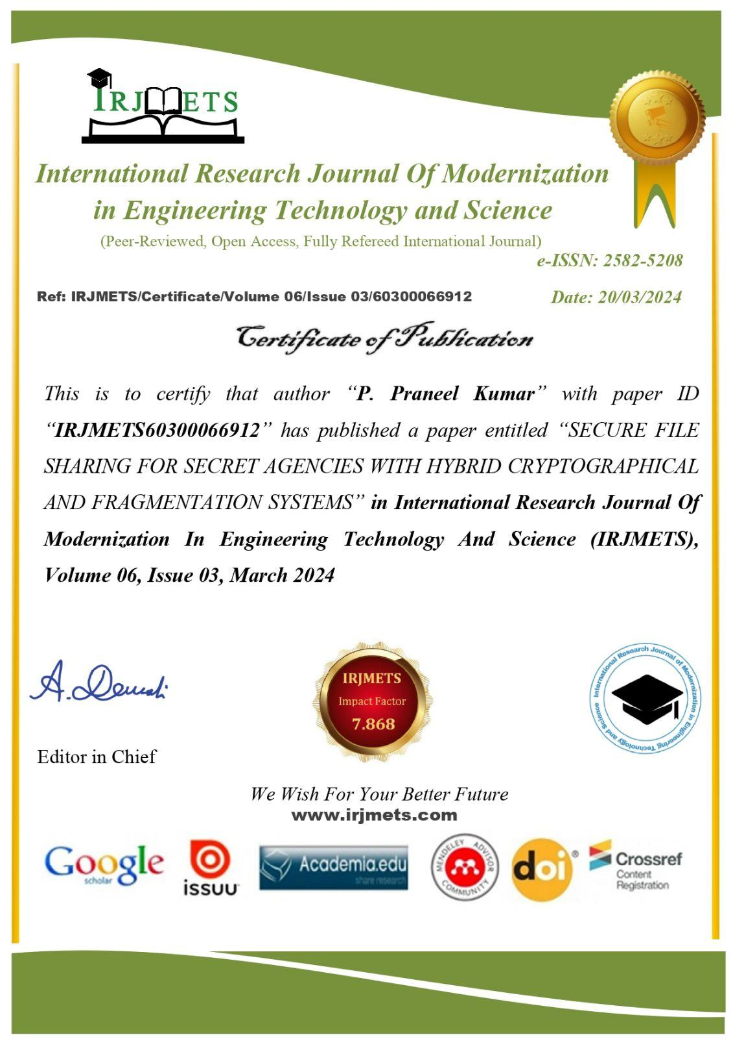
Cetifications

Slide 45

Cetifications

Slide 46
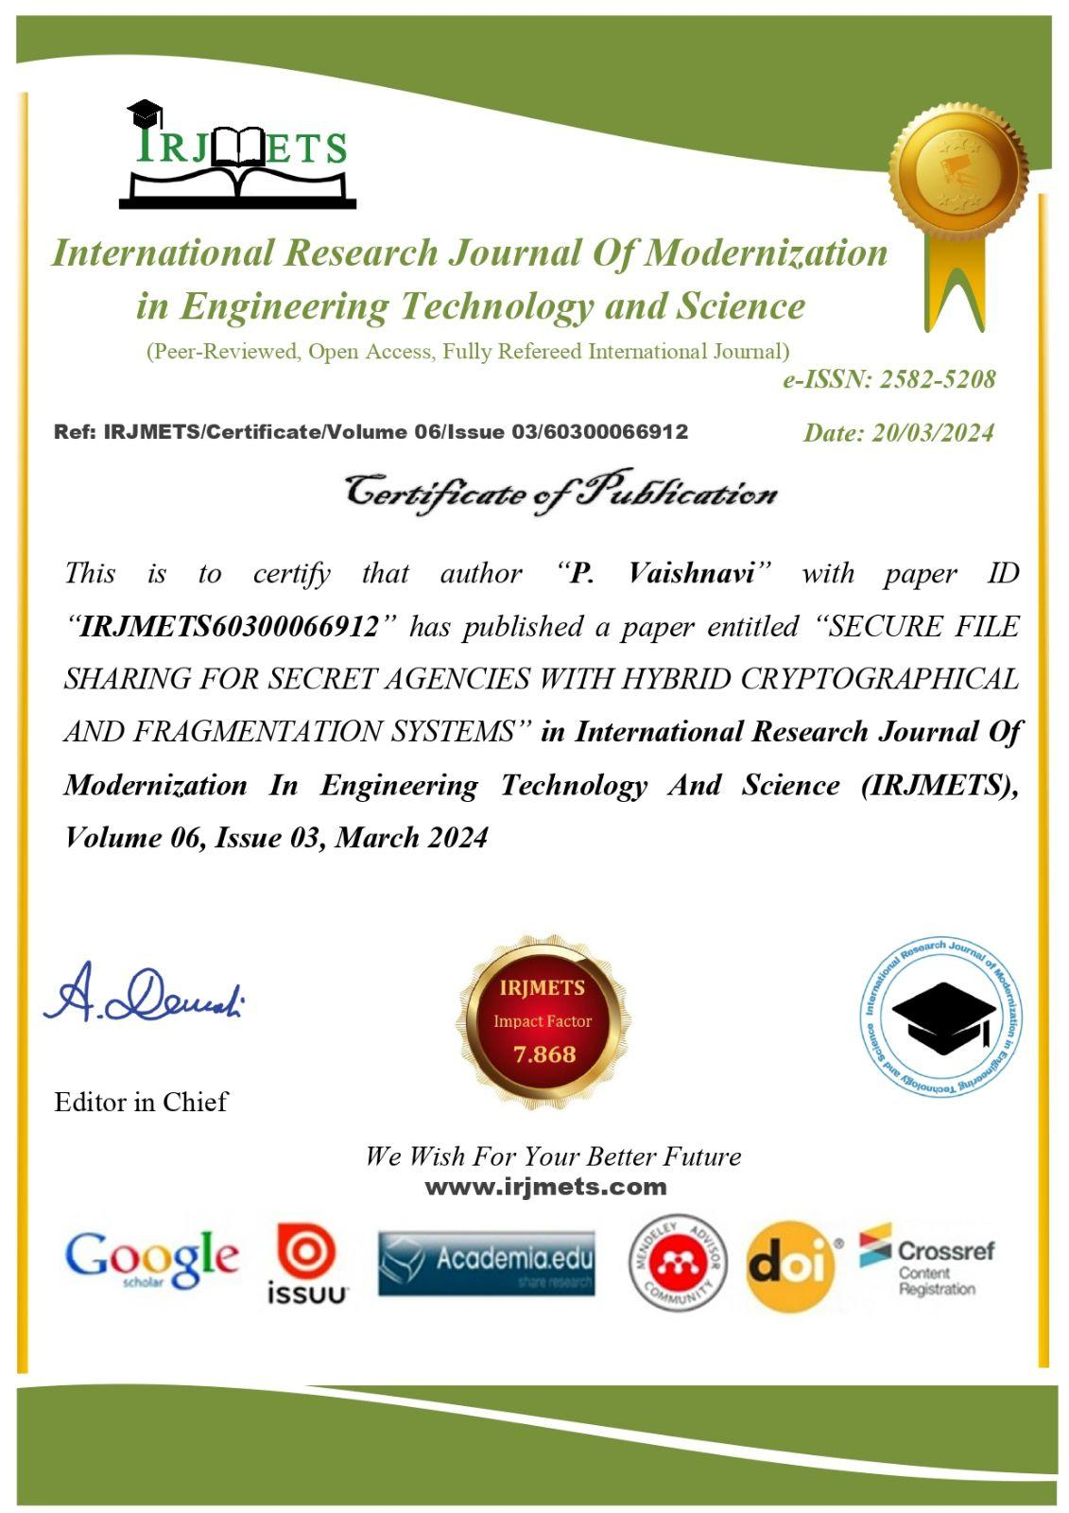
Cetifications

Slide 47

Cetifications

Slide 48

Cetifications

Slide 49
References
[1]. Y. Yang, X. Liu, R.H. Deng, “Multi-user Multi-Keyword Rank Search over Encrypted Data in Arbitrary Language”.
[2]. W. Sun, S. Yu, W. Lou, Y. Hou and H. Li, “Protecting Your Right: Verifiable Attribute-based Keyword Search with Fine-grained”.
[3]. M. Green, S. Hohenberger, and B.Waters, “Outsourcing the decryption of ABE ciphertexts,”.
[4]. J. Lai, R. H. Deng, C. Guan, and J. Weng, “Attribute-based encryption with verifiable outsourced decryption”.
[5]. Z. Liu, Z. Cao, D.S. Wong, “White-box traceable cipher text-policy attribute-based encryption supporting any monotone access structures”.

Slide 50
GitHub Dashboard
GitHub Link :

Slide 51
Thank You!!!

